Slide 1
Teaching Matters!
Turn High Quality Standards into Successful Mathematics Learning
Diane J. Briars
President
National Council of Teachers of Mathematics dbriars@nctm.org
National Title I Conference
January 30, 2016

Slide 2
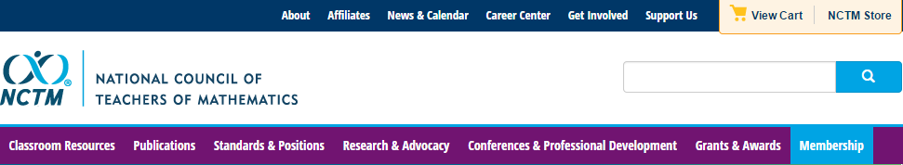
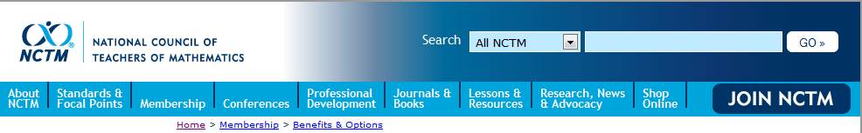
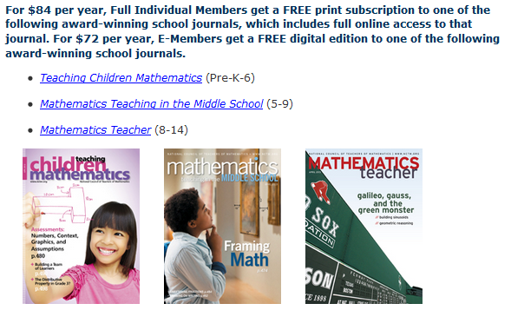
National Council of Teachers of Mathematics www.nctm.org

Slide 3



National Council of Teachers of Mathematics www.nctm.org
National Council of Teachers of Mathematics
www.nctm.org
For $144 per year, your school will get a FREE print-only subscription to one of the following award-winning journals:
Five FREE E-Memberships for teachers in your school
All the benefits of an e-membership including full access to
the digital edition of Teaching Children Mathematics or
Mathematics Teaching in the Middle School (a $72 value!) FREE!
To involve more teachers, additional e-memberships can be added
for just $10 each.

Slide 4
National Council of Teachers of Mathematics www.nctm.org
National Council of Teachers of Mathematics
www.nctm.org
New Member Discount
$20 off for full membership
$10 off e-membership
$5 off student membership
Use Code: BDB0616

Slide 5

NCTM Conferences www.nctm.org
  2016 Annual Meeting and Exposition
  April 13–16, 2016
  San Francisco

Slide 6
NCTM Interactive Institutes www.nctm.org
Engaging Students in Learning: Mathematical Practices, Grades K-8
July 11 – July 13, 2016, Atlanta, GA
Engaging Students in Learning: Mathematical Practices and Process Standards, High School
July 14 – July 16, 2016, Atlanta, GA
Algebra Readiness Institute, Grades 6-8
July 18-20, 2016, Denver, CO
Number and Operations Institute, Grades Pk-5
July 21-23, 2016, Denver CO

Slide 7
NCTM Regional Conferences www.nctm.org
Phoenix
October 26–28, 2016
Philadelphia, PA
October 31–November 2, 2016

Slide 8

NCTM Innov8
November 16-18, 2016, St. Louis
“Engaging the Struggling Learner”
Community. Collaboration. Solutions.
Bring your team and engage in a hands-on, interactive, and new
learning experience for mathematics education.
With a focus on “Engaging the
Struggling Learner,” become part
of a team environment and navigate
your experience through three
different pathways:
Response to Intervention (RtI)
Supporting productive struggle
Motivating the struggling learner
Proposal submission: February 1 – March 1

Slide 9

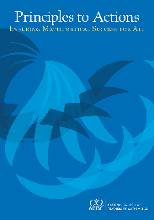
Agenda
Discuss key shifts in instructional practice required to implement Common Core State Standards for Mathematics and other college and career-ready standards.
Read and analyze a short case of a teacher (Mr. Harris) who is attempting to support his students’ learning.
Discuss selected effective teaching practices as described in NCTM’s Principles to Actions: Ensuring Mathematical Success for All, and relate them to the case.

Slide 10
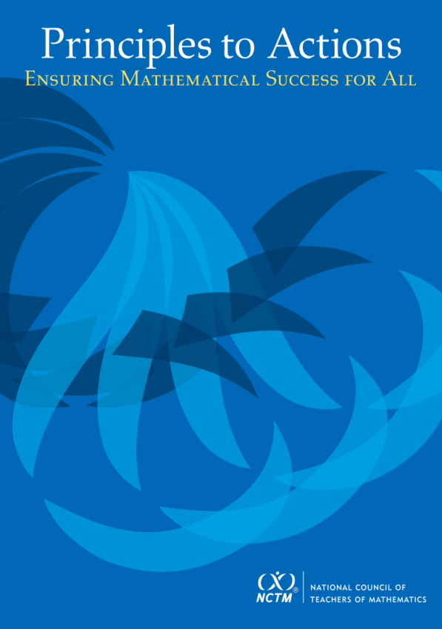
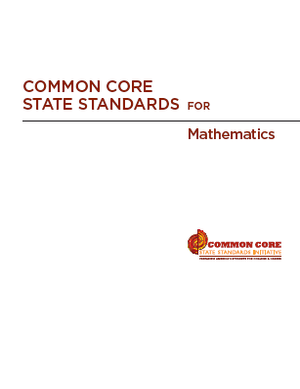
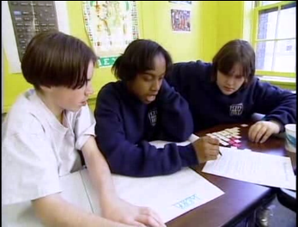
High Quality Standards Are Necessary, but Insufficient, for Effective Teaching and Learning

Slide 11
Principles to Actions:
Ensuring Mathematical Success for All
  Describes the supportive conditions, structures, and policies required to give all students the power of mathematics
  Focuses on teaching and learning
  Emphasizes engaging students in mathematical thinking
  Describes how to ensure that mathematics achievement is maximized for every student
  Is not specific to any standards; it’s universal

Slide 12
Key Features of CCSS-M
Focus: Focus strongly where the standards focus.
Coherence: Think across grades, and link to major topics
Rigor: In major topics, pursue conceptual understanding, procedural skill and fluency, and application
Standards for Mathematical Practice

Slide 13
Key Features of CCSS-M
Focus: Focus strongly where the standards focus.
Coherence: Think across grades, and link to major topics
Rigor: In major topics, pursue conceptual understanding, procedural skill and fluency, and application
Standards for Mathematical Practice

Slide 14
Curriculum Standards,
Not Assessment Standards
Understand and apply properties of operations and the relationship between addition and subtraction. (1.OA)
3. Apply properties of operations as strategies to add and subtract. Examples: If 8 + 3 = 11 is known, then 3 + 8 = 11 is also known. (Commutative property of addition.) To add 2 + 6 + 4, the second two numbers can be added to make a ten, so 2 + 6 + 4 = 2 + 10 = 12. (Associative property of addition.)
4. Understand subtraction as an unknown-addend problem. For example, subtract 10 – 8 by finding the number that makes 10 when added to 8.

Slide 15
Curriculum Standards,
Not Assessment Standards
Define, evaluate, and compare functions. (8.F)
1. Understand that a function is a rule that assigns to each input exactly one output. The graph of a function is the set of ordered pairs consisting of an input and the corresponding output.

Slide 16
Why Focus on Understanding??
Understanding facilitates initial learning and retention.
Understanding supports appropriate application and transfer.

Slide 17
Key Features of CCSS-M
Focus: Focus strongly where the standards focus.
Coherence: Think across grades, and link to major topics
Rigor: In major topics, pursue conceptual understanding, procedural skill and fluency, and application
Standards for Mathematical Practice

Slide 18
Key Features of CCSS-M
Focus: Focus strongly where the standards focus.
Coherence: Think across grades, and link to major topics
Rigor: In major topics, pursue conceptual understanding, procedural skill and fluency, and application
Standards for Mathematical Practice

Slide 19
Standards for Mathematical Practice
  Make sense of problems and persevere in solving them.
  Reason abstractly and quantitatively.
  Construct viable arguments and critique the reasoning of others.
  Model with mathematics.
  Use appropriate tools strategically.
  Attend to precision.
  Look for and make use of structure.
  Look for and express regularity in repeated reasoning.

Slide 20
Phil Daro, 2010
Notes:
20

Slide 21
Phil Daro, 2010
Notes:
21

Slide 22
Other “Butterflies”?
FOIL
Cross multiplication
Keep-change-flip, KFC, etc.
Keep-change-change
Does McDonalds Sell Cheese Burgers?
Key words
(a - b = a + ⁻ b)

Slide 23
Key Instructional Shift
From emphasis on:
How to get answers
To emphasis on:
Understanding mathematics

Slide 24
Implementing CCSS-M Requires
Instructional practices that promote students’ development of conceptual understanding and proficiency in the Standards for Mathematical Practice.

Slide 25
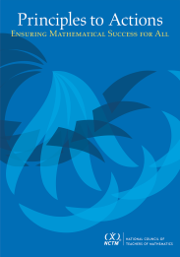
We Must Focus on Instruction
Student learning of mathematics “depends fundamentally on what happens inside the classroom as teachers and learners interact over the curriculum.”
(Ball & Forzani, 2011, p. 17)
“Teaching has 6 to 10 times as much impact on achievement as all other factors combined ... Just three years of effective teaching accounts on average for an improvement of 35 to 50 percentile points.”
Schmoker (2006, p.9)

Slide 26
Guiding Principles
for School Mathematics
Teaching and Learning
Effective teaching is the non-negotiable core that ensures that all students learn mathematics at high levels.

Slide 27
Guiding Principles
for School Mathematics
Teaching and Learning
Access and Equity
Curriculum
Tools and Technology
Assessment
Professionalism
Essential Elements
of Effective Math
Programs

Slide 28

The Band Concert
Make a quick sketch or diagram of the situation.
How might
Grade 3 students approach this task?
The third-grade class is responsible for setting
up the chairs for their spring band concert. In
preparation, they need to determine the total
number of chairs that will be needed and ask
the school’s engineer to retrieve that many
chairs from the central storage area.
The class needs to set up 7 rows of chairs with
20 chairs in each row, leaving space for a center aisle.
How many chairs does the school’s engineer need
to retrieve from the central storage area?
Notes:
Allow about 1 minute.

Slide 29
The Case of Mr. Harris and the Band Concert Task
Read the Case of Mr. Harris and study the strategies used by his students.
Make note of what Mr. Harris did before or during instruction to support his students’ developing understanding of multiplication.
Talk with the people at your table about the “Teaching Practices” Mr. Harris is using and how they support students’ progress in their learning.
Be prepared to share the Teaching Practices that you discussed.
Notes:
Allow 7 minutes to read the case and talk.

Slide 30
Teaching and Learning Principle
An excellent mathematics program requires effective teaching that engages students in meaningful learning through individual and collaborative experiences that promote their ability to make sense of mathematical ideas and reason mathematically.

Slide 31
Relating the Case to the
Mathematics Teaching Practices
Establish mathematics goals to focus learning.
Implement tasks that promote reasoning and problem solving.
Use and connect mathematical representations.
Facilitate meaningful mathematical discourse.
Pose purposeful questions.
Build procedural fluency from conceptual understanding.
Support productive struggle in learning mathematics.
Elicit and use evidence of student thinking.

Slide 32
Establish Mathematics Goals
To Focus Learning
Learning Goals should:
Clearly state what it is students are to learn and understand about mathematics as the result of instruction;
Be situated within learning progressions; and
Frame the decisions that teachers make during a lesson.
Formulating clear, explicit learning goals sets the stage for everything else.
(Hiebert, Morris, Berk, & Janssen, 2007, p.57)

Slide 33
Mr. Harris’ Math Goals
  Students will recognize the structure of multiplication as equal groups within and among different representations, focusing on identifying the number of equal groups and the size of each group within collections or arrays.
Student-friendly version ...
We are learning to represent and solve word problems and explain how different representations match the story situation and the math operations.

Slide 34
Alignment to the
Common Core State Standards
Standard 3.OA.3. Use multiplication and division within 100 to solve word problems in situations involving equal groups, arrays, and measurement quantities, e.g., by using drawings and equations with a symbol for the unknown number to represent the problem.
Standard 3.NBT. 3. Multiply one-digit whole numbers by multiples of 10 in the range 10–90 (e.g., 9 x 80, 5 x 60) using strategies based on place value and properties of operations.

Slide 35
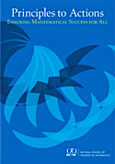
What were the math expectations
for student learning?
In what ways did these math goals focus the teacher’s interactions with students throughout the lesson?
Consider Case Lines 4-9, 21-24, 27-29.

Slide 36
Implement Tasks that Promote
Reasoning and Problem Solving
Mathematical tasks should:
Provide opportunities for students to engage in exploration or encourage students to use procedures in ways that are connected to concepts and understanding;
Build on students’ current understanding; and
Have multiple entry points.

Slide 37
Why Tasks Matter
Tasks form the basis for students’ opportunities to learn what mathematics is and how one does it;
Tasks influence learners by directing their attention to particular aspects of content and by specifying ways to process information;
The level and kind of thinking required by mathematical instructional tasks influences what students learn; and
Differences in the level and kind of thinking of tasks used by different teachers, schools, and districts, is a major source of inequity in students’ opportunities to learn mathematics.

Slide 38
Why Tasks Matter
Tasks form the basis for students’ opportunities to learn what mathematics is and how one does it;
Tasks influence learners by directing their attention to particular aspects of content and by specifying ways to process information;
The level and kind of thinking required by mathematical instructional tasks influences what students learn; and
Differences in the level and kind of thinking of tasks used by different teachers, schools, and districts, is a major source of inequity in students’ opportunities to learn mathematics.

Slide 39
Compare Band Concert to:
Find the product
5 x 20 =
6 x 80 =
4 x 70 =
3 x 50 =
9 x 20 =
2 x 60 =
8 x 30 =
How is the Band Concert task similar to or different from the find the product problems?
Which one is more likely to promote problem solving?
Notes:
6076 (1.037)^{t}
21,671
Algebra 2
Holt, Rinehart and Winston, 2004
Page 415

Slide 40
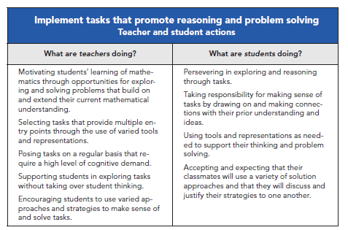

Slide 41
Core Instructional Issue
Do all students have the opportunity to engage in mathematical tasks that promote students’ attainment of the mathematical practices on a regular basis?

Slide 42
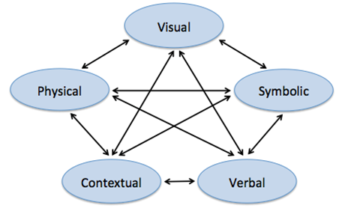
Use and Connect
Mathematical Representations
Different Representations should:
Be introduced, discussed, and connected;
Focus students’ attention on the structure or essential features of mathematical ideas; and
Support students’ ability to justify and explain their reasoning.
Strengthening the ability to move between and among these representations improves the growth of children’s concepts.
Lesh, Post, Behr, 1987

Slide 43

Important Mathematical Connections between and within different types of representations
Visual
Physical
Symbolic
Contextual
Verbal
Principles to Actions (NCTM, 2014, p. 25)
(Adapted from Lesh, Post, & Behr, 1987)

Slide 44
What mathematical representations were students working with in the lesson?
How did Mr. Harris
support students in making connections between and
within different types of representations?
How did students benefit from making these connections?
Visual
Physical
Symbolic
Contextual
Verbal

Slide 45
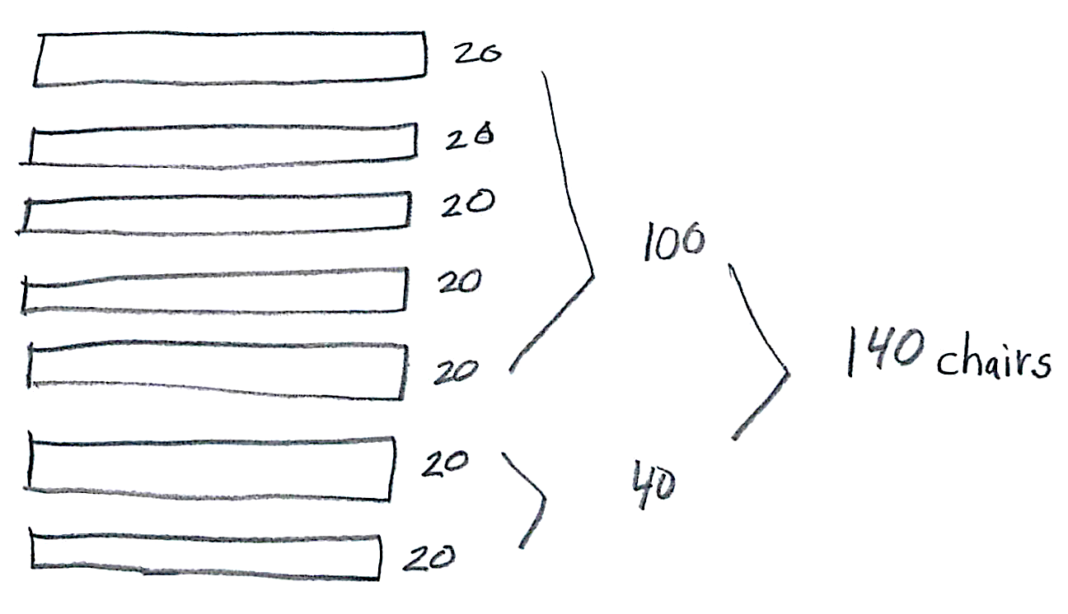
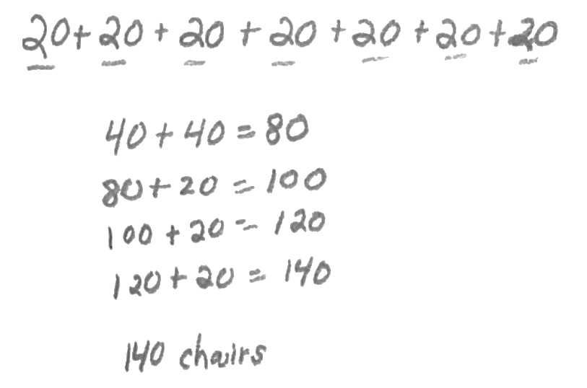
Consider Lines 43-48.
In what ways did comparing representations strengthen the understanding of these students?
Jasmine
Kenneth

Slide 46
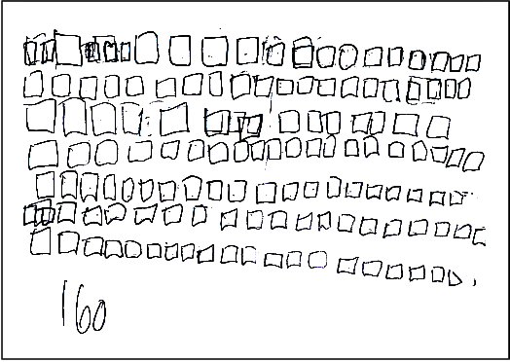
Consider Lines 48-49.
How did comparing representations benefit Molly?
Molly

Slide 47
Facilitate Meaningful
Mathematical Discourse
Mathematical Discourse should:
Build on and honor students’ thinking.
Let students share ideas, clarify understandings, and develop convincing arguments.
Engage students in analyzing and comparing student approaches.
Advance the math learning of the whole class.

Slide 48
Facilitate
Meaningful Mathematical Discourse
Discussions that focus on cognitively challenging mathematical tasks, namely those that promote thinking, reasoning, and problem solving, are a primary mechanism for promoting conceptual understanding of mathematics (Hatano & Inagaki, 1991; Michaels, O’Connor, & Resnick, 2008).
Smith, Hughes, Engle & Stein, 2009, p. 549

Slide 49
Meaningful Discourse
What did Mr. Harris do (before or during the discussion) that may have positioned him to engage students in a productive discussion?

Slide 50
Structuring Mathematical Discourse...
During the whole class discussion
of the task, Mr. Harris was strategic in:
Selecting specific student representations and strategies for discussion and analysis.
Sequencing the various student approaches for analysis and comparison.
Connecting student approaches to
key math ideas and relationships.

Slide 51
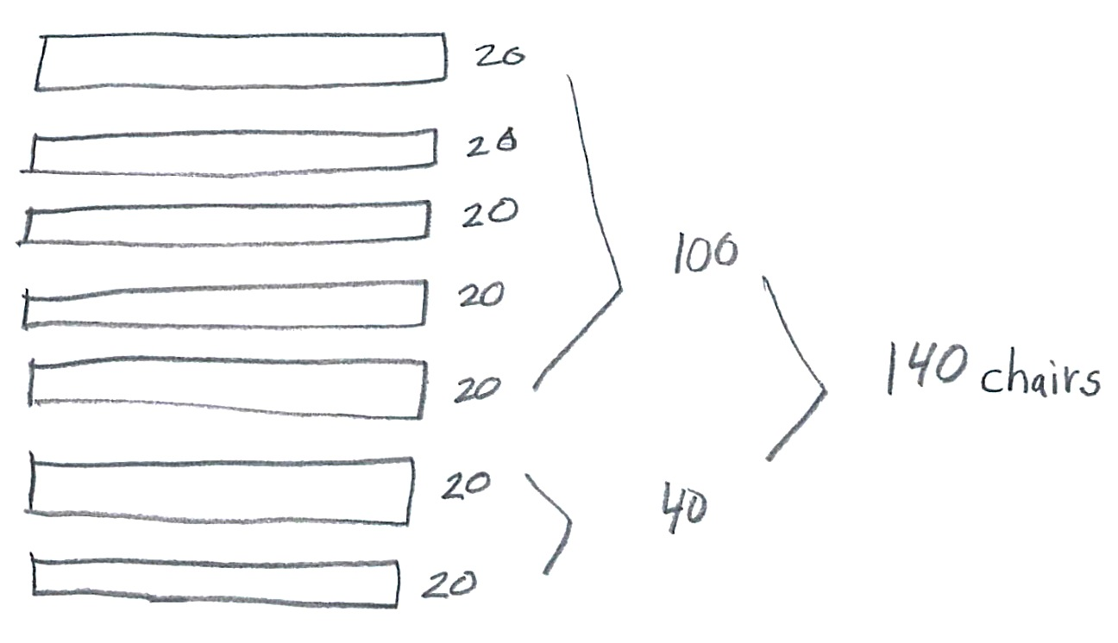
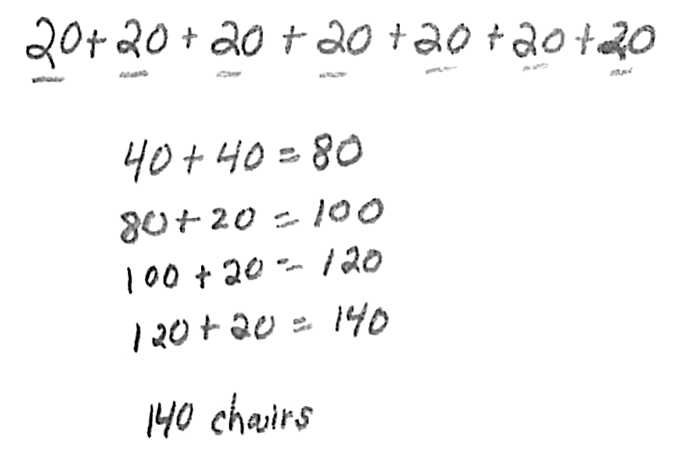
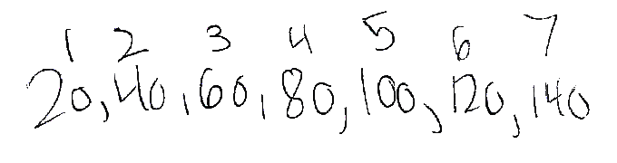
Consider Lines 52-57.
Why did Mr. Harris select and sequence the work of these three students and how did that support student learning?
Jasmine
Kenneth
Teresa
Notes:
Not just “show and tell” but a purposeful journey that he took his students on and helped them make key connections along the way.
--went from Jasmine to Kenneth to Teresa
--relating skip counting to multiplication is important; when you get to 100 what does that tell you about the number of twenties?
--Note that he saved Tyrell and Ananda’s work until the end of the lesson and didn’t really dig into them until a subsequent lesson.

Slide 52

Anticipating
Monitoring
Selecting
Sequencing
Connecting
5 Practices for Orchestrating
Productive
Mathematics
Discussions
(Smith & Stein, 2011)
Notes:
The 5 practices are meant to make student-centered instruction more manageable by having a plan and a map to follow to holding classroom discussions.
--The practices emphasize the importance of planning. Through planning, teachers can anticipate likely student contributions and be more ready to respond to them; and also have a map of how to structure students’ presentations of their work to further the mathematical agenda for the lesson.
We can see evidence of Mr. Harris engaging in practices 2-5 in the case; although there is no direct evidence that she engaged in ANTICIPATING it is unlikely that he could have engaged in any of the other practices had he not anticipated first.

Slide 53
Planning with the Student in Mind
Anticipate solutions, thoughts, and responses that students might develop as they struggle with the problem
Generate questions that could be asked to promote student thinking during the lesson, and consider the kinds of guidance that could be given to students who showed one or another types of misconception in their thinking
Determine how to end the lesson so as to advance students’ understanding
  Stigler & Hiebert, 1997

Slide 54
Pose Purposeful Questions
Effective Questions should:
Reveal students’ current understandings;
Encourage students to explain, elaborate, or clarify their thinking; and
Make the mathematics more visible and accessible for student examination and discussion.

Slide 55
Pose Purposeful Questions
Teachers’ questions are crucial in helping students make connections and learn important mathematics and science concepts. Teachers need to know how students typically think about particular concepts, how to determine what a particular student or group of students thinks about those ideas, and how to help students deepen their understanding.
Weiss & Pasley, 2004

Slide 56
Purposeful Questions
Lines 33-36
“How does your drawing show 7 rows?”
“How does your drawing show that there are
20 chairs in each row?
“How many twenties are you adding, and why?”
“Why are you adding all those twenties?
  Math Learning Goal
  Students will recognize the structure of multiplication as equal groups within and among different representations—identify the number of equal groups and the size of each group within collections or arrays.

Slide 57
Pose Purposeful Questions
Can someone tell me or share with me another way?
Do you think that means the same things?
Is there another opinion about this?
Why did you say that, Justin?
How did you get that?
How do you know that?
Can you explain your idea?
Why?
Can you convince us?
Did anyone get something
else?
Boaler, J., & Brodie, K. (2004)

Slide 58
Build Procedural Fluency from Conceptual Understanding
Procedural Fluency should:
Build on a foundation of conceptual understanding;
Result in generalized methods for solving problems; and
Enable students to flexibly choose among methods to solve contextual and mathematical problems.

Slide 59
Build Procedural Fluency from Conceptual Understanding
Students must be able to do much more than carry out mathematical procedures. They must know which procedure is appropriate and most productive in a given situation, what a procedure accomplishes, and what kind of results to expect. Mechanical execution of procedures without understanding their mathematical basis often leads to bizarre results.
Martin, 2009, p. 165

Slide 60
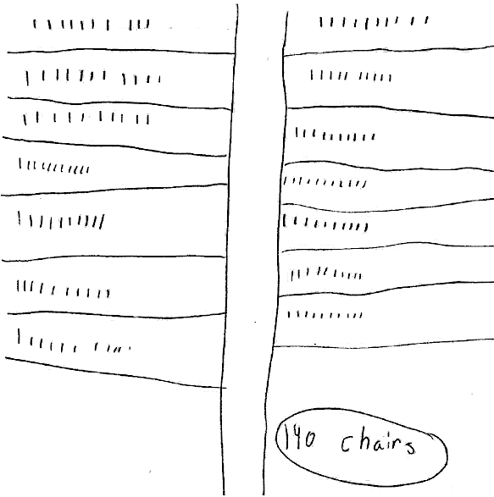
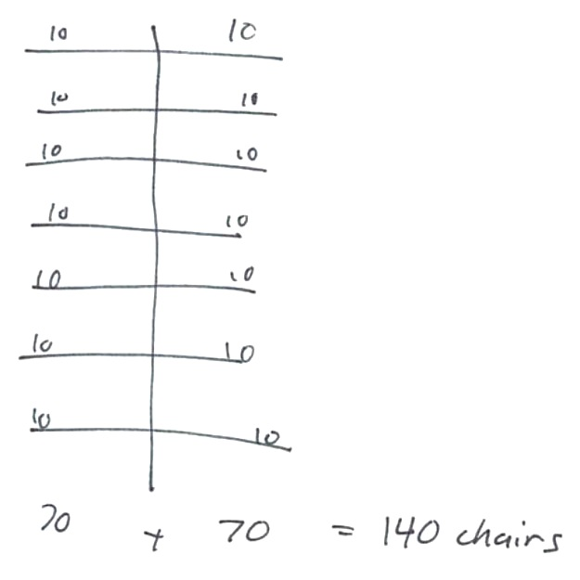
How might this student work be used to develop the understanding that 14 tens = 140 and to meaningfully to build toward fluency in working with multiples of ten.
Tyrell
Ananda

Slide 61
“Fluency builds from initial exploration and discussion of number concepts to using informal reasoning strategies based on meanings and properties of the operations to the eventual use of general methods as tools in solving problems.”
Principles to Actions (NCTM, 2014, p. 42)

Slide 62
Support Productive Struggle
in Learning Mathematics
Productive Struggle should:
Be considered essential to learning mathematics with understanding;
Develop students’ capacity to persevere in the face of challenge; and
Help students realize that they are capable of doing well in mathematics with effort.

Slide 63
Support Productive Struggle in Learning Mathematics
The struggle we have in mind comes from solving problems that are within reach and grappling with key mathematical ideas that are comprehendible but not yet well formed
Hiebert et al., 1996
By struggling with important mathematics we mean the opposite of simply being presented information to be memorized or being asked only to practice what has been demonstrated.
Hiebert & Grouws, 2007, pp. 387-388
Notes:
Not talking about giving students impossible problems to.
CLICK ON QUOTE
Students need to be able to figure things out for themselves…it is through this process of figuring things own that they will develop authority and ownership of their own learning.

Slide 64
How did Mr. Harris support productive struggle among his students, individually and collectively, as they grappled with important mathematical ideas and relationships?
At which points in the lesson might Mr. Harris have consciously restrained himself from “taking over” the thinking of his students?

Slide 65
Elicit and Use Evidence
of Student Thinking
Evidence should:
Provide a window into students’ thinking;
Help the teacher determine the extent to which students are reaching the math learning goals; and
Be used to make instructional decisions during the lesson and to prepare for subsequent lessons.

Slide 66
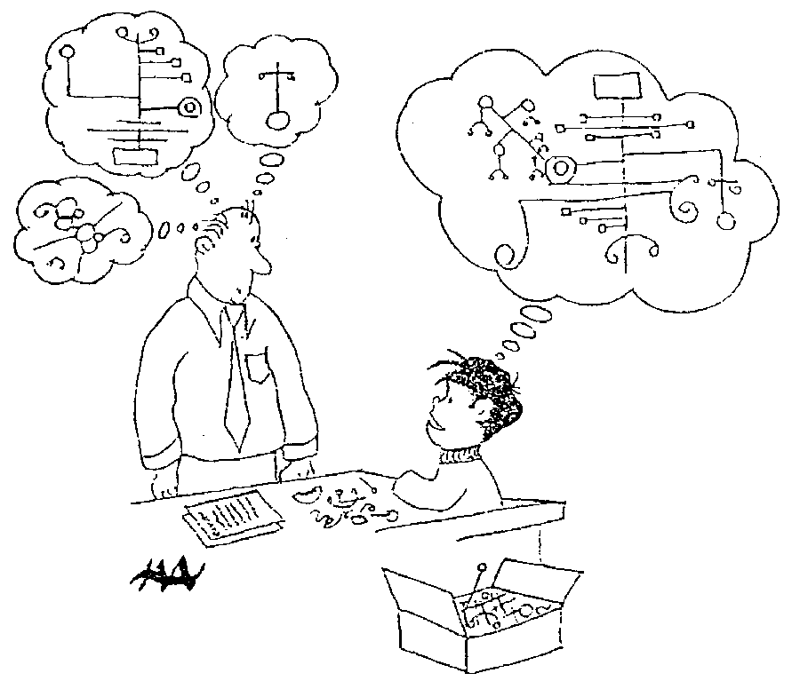
Harold Asturias, 1996
Notes:
This cartoon illustrates what assessment is really about.
Each student develops some concept of mathematics is. Our jobs as teachers and administrators is to figure out what is going on in our students heads.
What do they really understand about mathematics? Unfortunately we can’t just open up the kid’s head and look.
We are restricted to look at visible and tangible evidence---what they say and do. In classrooms, we have a wide variety of evidence available for us.
At the district level, we are often stuck with what kids actually do, often on on-demand types of test.
A critical question is how good are our inferences? To what extent are we actually developing a accurate perception of what kids actually know?
This is what we are call valid inferences. We are making inferences of what children know when our idea of what they know matches, as well as possible, to what they actually understand. We never want to assume that they know something that they don’t, and we also don’t want to assume that they don’t know something that they do.

Slide 67
Formative assessment is an essentially interactive process, in which the teacher can find out whether what has been taught has been learned, and if not, to do something about it. Day-to-day formative assessment is one of the most powerful ways of improving learning in the mathematics classroom.
Wiliam, 2007, pp. 1054; 1091

Slide 68
Examples of Eliciting and Using Evidence
Throughout the lesson, Mr. Harris was eliciting and using evidence of student thinking.
Lines 33-36: Purposeful questioning as students worked individually.
Lines 43-51: Observations of student pairs discussing and comparing their representations.
Lines 59-74: Whole class discussion.
Lines 78-80: Asked students to respond in writing.

Slide 69
Effective
Mathematics Teaching Practices
Establish mathematics goals to focus learning.
Implement tasks that promote reasoning and problem solving.
Use and connect mathematical representations.
Facilitate meaningful mathematical discourse.
Pose purposeful questions.
Build procedural fluency from conceptual understanding.
Support productive struggle in learning mathematics.
Elicit and use evidence of student thinking.

Slide 70
Effective
Mathematics Teaching Practices
You do
We do
I do
NOT
I do
We do
You do
X

Slide 71
Effective
Mathematics Teaching Practices
Establish mathematics goals to focus learning.
Implement tasks that promote reasoning and problem solving.
Use and connect mathematical representations.
Facilitate meaningful mathematical discourse.
Pose purposeful questions.
Build procedural fluency from conceptual understanding.
Support productive struggle in learning mathematics.
Elicit and use evidence of student thinking.

Slide 72
Guiding Principles
for School Mathematics
Teaching and Learning
Access and Equity
Curriculum
Tools and Technology
Assessment
Professionalism
Essential Elements
of Effective Math
Programs

Slide 73
The Title is Principles to Actions
The Teaching and Learning Principle
Teacher Actions:
Consistently implement the eight Mathematics Teaching Practices.
Elicit, value, and celebrate varied approaches and solution paths that students take to solve mathematics problems, explain their thinking, and critique the arguments of others.

Slide 74
The Title is Principles to Actions
The Teaching and Learning Principle
Teacher Actions:
Give priority to the mathematical practices, including problem solving, reasoning, and constructing viable arguments in every aspect of classroom practice—including teaching, assessment, curriculum decisions, and the use of tools and technology.
Plan and implement units and lessons that promote positive dispositions toward the study of mathematics, including curiosity, self-confidence, flexibility, and perseverance.

Slide 75
The Title is Principles to Actions
Principals, Coaches, Specialists, and Other School Leaders
Make the eight Mathematics Teaching Practices a schoolwide focus that is expected for all teachers to
Strengthen learning and teaching for all students, and provide professional development, training, and coaching to make the implementation of these practices a priority;
Maintain a schoolwide culture with high expectations and a growth mindset; allocate time for teachers to collaborate in professional learning communities;
Support improvement with multifaceted assessments used to monitor progress and inform changes to instruction;
Make the mathematical success of every student a nonnegotiable priority.

Slide 76
The Title Is Principles to Actions
Your Actions?

Slide 77
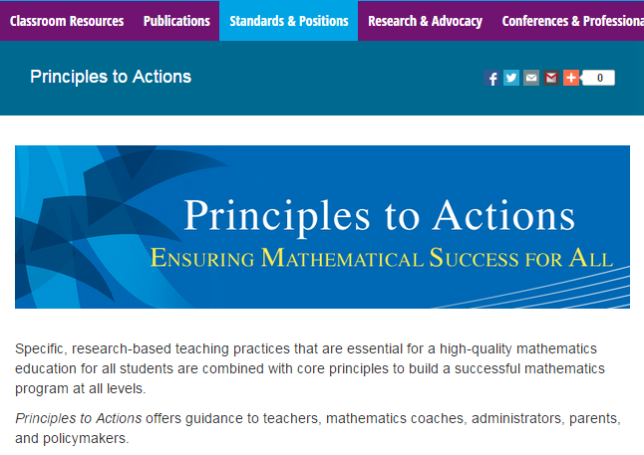
http://www.nctm.org/PtA/

Slide 78
Principles to Actions Resources
Principles to Actions Executive Summary
(in English and Spanish)
Principles to Actions overview presentation
Principles to Actions professional development guide (Reflection Guide)
Mathematics Teaching Practices presentations
  Elementary case, multiplication (Mr. Harris)
  Middle school case, proportional reasoning (Mr. Donnelly) (in English and Spanish)
  High school case, exponential functions (Ms. Culver)
Principles to Actions Spanish translation

Slide 79
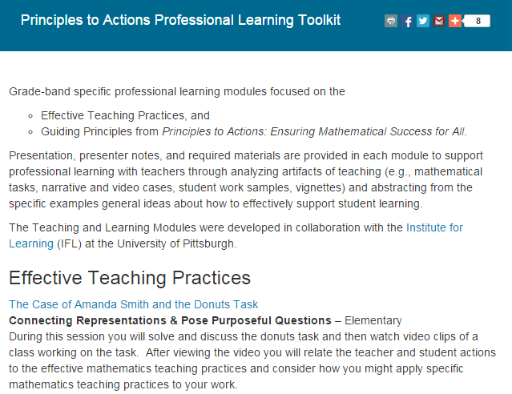
http://www.nctm.org/PtAToolkit/

Slide 80
  NCTM-Hunt Institute Video Series:
  Teaching and Learning Mathematics with the Common Core
    Enhance public understanding of what students need to know for college and career
    Why conceptual understanding requires a different approach
    Teachers, educators, leaders, and parents with classroom video
    Primarily for the public; useful to educator outreach

Slide 81

NCTM-Hunt Institute Video Series:
Teaching and Learning Mathematics with the Common Core
    Mathematics in the Early Grades
    Developing Mathematical Skills in Upper Elementary Grades
    Building Conceptual Understanding in Mathematics
    Mathematical Foundations for Success in Algebra
    Preparation for Higher Level Mathematics
    Parents: Supporting Mathematics Learning
    Standards for Mathematical Practice

Slide 82
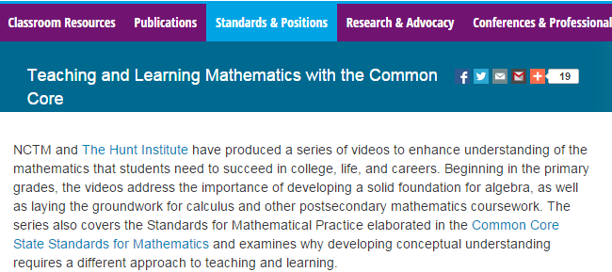
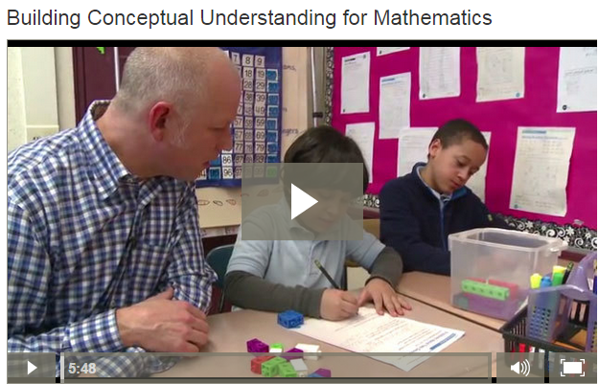
http://www.nctm.org/Standards-and-Positions/Common-Core-State-Standards/Teaching-and-Learning-Mathematics-with-the-Common-Core/

Slide 83
Thank You!
Diane Briars dbriars@nctm.org

